Slide 1
TechShoi
Database
Application
Updated
Check for this
Ahammad Shawki

Slide 2
Dates
28 April - Got an SRS of 14 lines and some sample data
2 May – Initial Planning complete & Meeting
8 May – Planning Confirmation
17 May – Started Implementation
21 May – UI/UX design completed + implemented
25 May – Admin Site Completed
27 May – Analytics Completed
29 May – Testing Completed
31 May – Final Meeting

Slide 3
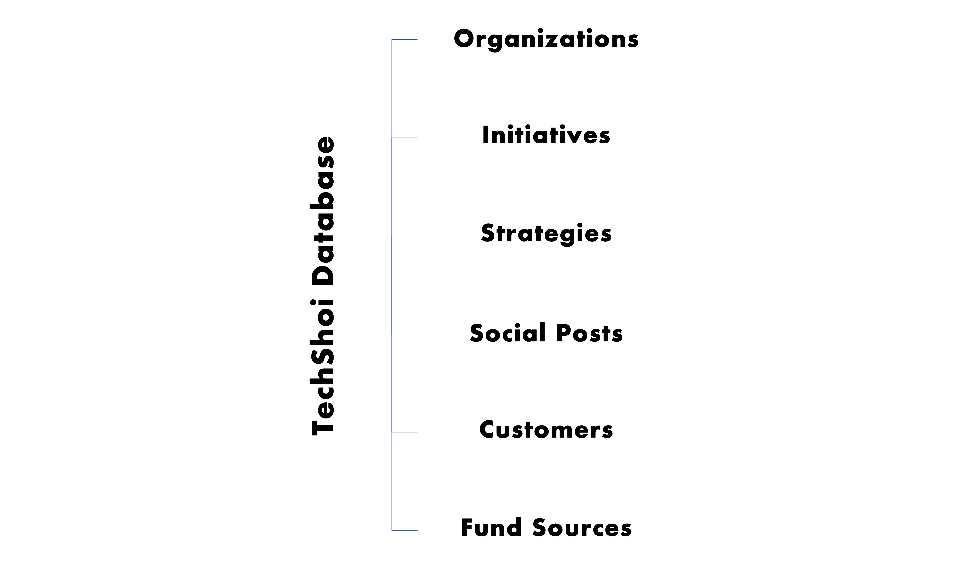
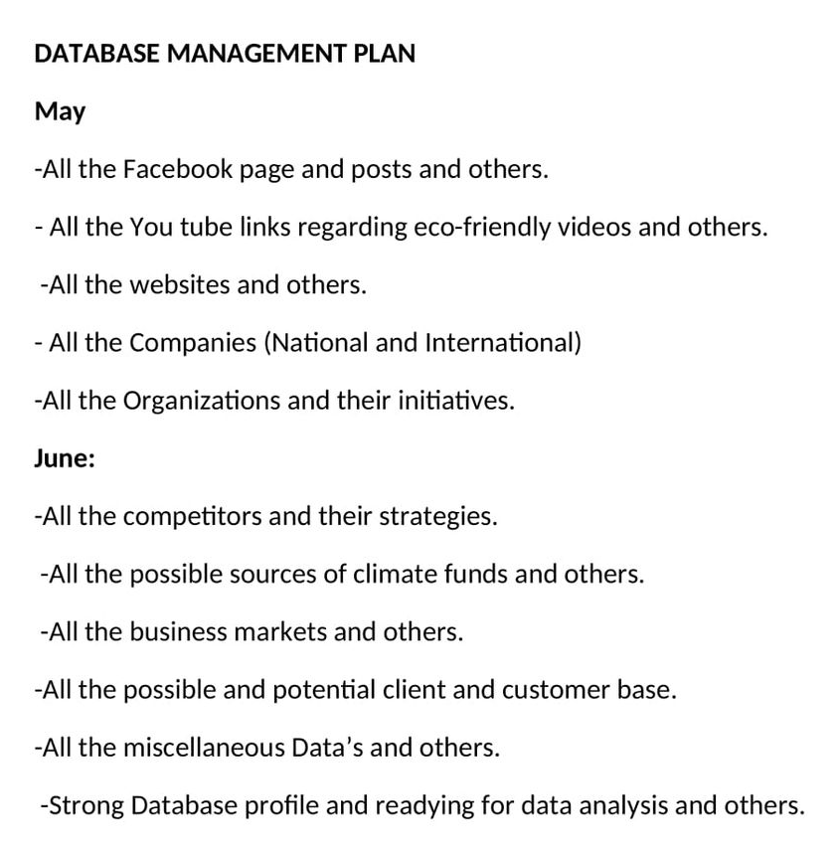
Fulfilling Requirements
Consumer
Tables - Requirements Plan

Slide 4
Databases & Tables
Database = 2
Authentication Database
Authentication Tables = 2
Core Database
Old Tables = 6
New Tables = 2

Slide 5
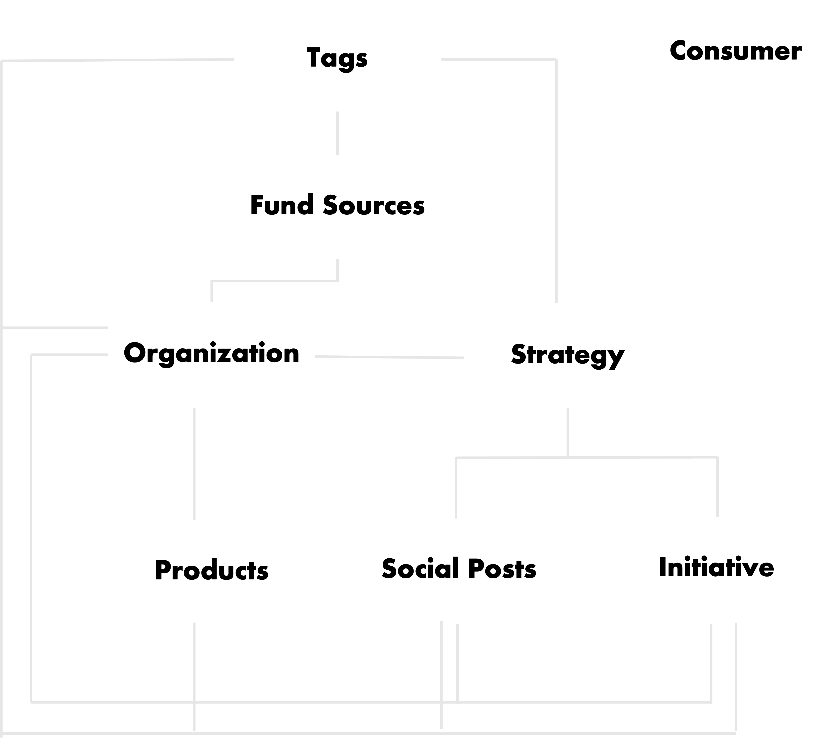
Tables Dependency Chart

Slide 6
Tables
Columns
Relationships
Plan.

Slide 7
New Table
Tags
Id | UUID, PRIMARY KEY, NOT NULL
Value | CHARFIELD(MAX_LENGTH = 50), NOT NULL, UNIQUE
Search Filter
Value
List Filter
-

Slide 8
Fund Sources
Id | UUID, PRIMARY KEY, NOT NULL
Name | CHARFIELD(MAX_LENGTH=100), NOT NULL, UNIQUE
Location | CHARFIELD(MAX_LENGTH=100), NOT NULL
Email | EMAIL_FIELD, UNIQUE CONSTRAINT, NOT NULL
Site | URL_FIELD, NOT NULL
Funding Possibility | SELECT_FIELD (Low | Medium | High), NOT NULL
Tags | MANY-TO-MANY RELATIONSHIP, NULL
Search Filter
Name, Location, Email, Site
List Filter
Funding Possibility, Tags

Slide 9
Organizations
Id | UUID, PRIMARY KEY, NOT NULL
Name | CHARFIELD(MAX_LENGTH=100), NOT NULL, UNIQUE
Location | CHARFIELD(MAX_LENGTH=100), NOT NULL
Category | SELECT_FIELD (COMPETITOR | NEUTRAL | MARKET | VENDORS), NOT NULL
Email | EMAIL_FIELD, UNIQUE CONSTRAINT, NULL
Site | URL_FIELD, NULL
Status | SELECT_FIELD(ACTIVE | INACTIVE), NOT NULL
Funder | MANY-TO-MANY RELATIONSHIP, NULL
Tags | MANY-TO-MANY RELATIONSHIP, NULL
Search Filter
Name, Location, Email, Site
List Filter
Category, Status, Funder, Tags

Slide 10
Strategies
Id | UUID, PRIMARY KEY, NOT NULL
Name | TEXT_FIELD, NOT NULL, UNIQUE
Organization | FOREIGN KEY, NULL
Tags | MANY-TO-MANY RELATIONSHIP, NULL
Search Filter
Name
List Filter
Organization, Tags

Slide 11
Initiatives
Id | UUID, PRIMARY KEY, NOT NULL
Name | TEXT_FIELD, NOT NULL, UNIQUE
Date | DATEFIELD, NULL
Link | URL_FIELD, NULL
Organization | FOREIGN KEY, NOT NULL
Strategy | MANY TO MANY RELATIONSHIP
Tags | MANY-TO-MANY RELATIONSHIP, NULL
Search Filter
Name, Link
List Filter
Date, Organization, Strategy, Tags

Slide 12
Social Posts
Id | UUID, PRIMARY KEY, NOT NULL
Platform | CHARFIELD(MAX_LENGTH=100), NOT NULL
Date | DATEFIELD, NULL
Link | URL_FIELD, NOT NULL
Organization Id | FOREIGN KEY, NOT NULL
Strategy Id | MANY-TO-MANY RELATIONSHIP, NOT NULL
Tags | MANY-TO-MANY RELATIONSHIP, NULL
Search Filter
Link
List Filter
Platform, Date, Organization, Strategy, Tags

Slide 13
New Table
Products
Id | UUID, PRIMARY KEY, NOT NULL
Name | CHARFIELD(MAX_LENGTH = 100), NOT NULL
Price | INTEGER FIELD, NOT NULL
Date | DATEFIELD, NULL
Features | TEXT_FIELD, NOT NULL
Link | URL_FIELD, NULL
Organization Id | FOREIGN KEY, NOT NULL
Tags | MANY-TO-MANY RELATIONSHIP, NULL
Search Filter
Name, Features, Link
List Filter
Price, Date, Organization, Tags

Slide 14
Consumer
Id | UUID, PRIMARY KEY, NOT NULL
Name | CHARFIELD(MAX_LENGTH = 100), NOT NULL
Email | EMAIL_FIELD, UNIQUE CONSTRAINT, NULL
Age | INTEGER_FIELD, NOT NULL
Location | TEXT_FIELD, NULL
Social Link | URL_FIELD, NULL
Search Filter
Name, Email, Location, Social Link
List Filter
Age

Slide 15
Data Entry Rules
Location
Dhaka, Bangladesh
Delhi, India
Site / link
Starts with https://
Be Careful when deleting records
Report Bugs when necessary
Notify me anytime when face an error

Slide 16
DATA
ANALYSIS &
VISUALIZATION
Plan.

Slide 17
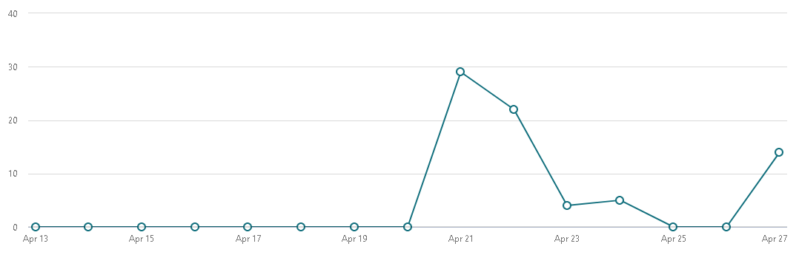
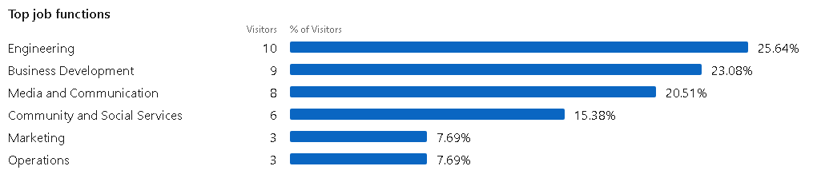
SOME EXAMPLES
LinkedIn

Slide 18
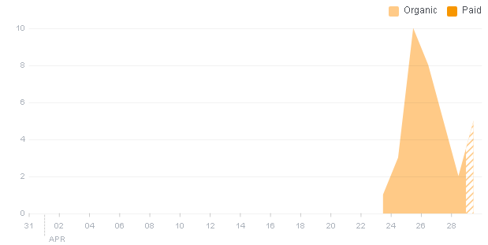
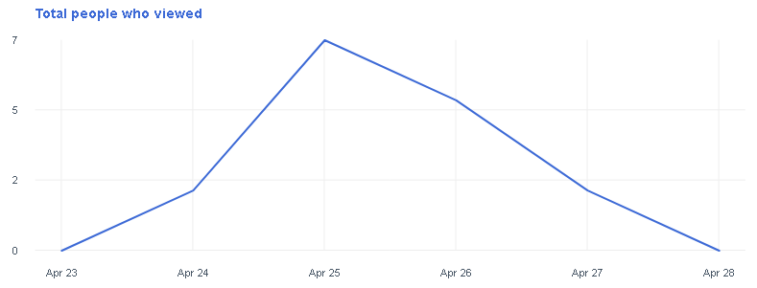
Facebook

Slide 19
Data Analysis Ideas
Fund Sources Location (Bar)
Fund Sources Funding Possibility (Pie)
Organization Location (Bar)
Organization Category (Pie)
Organization Status (Pie)
Social Post Platforms (Pie)
Product Price (Hist)
Consumer Location (Bar)
Consumer Age (Hist)

Slide 20
Implementations
UIUX

Slide 21
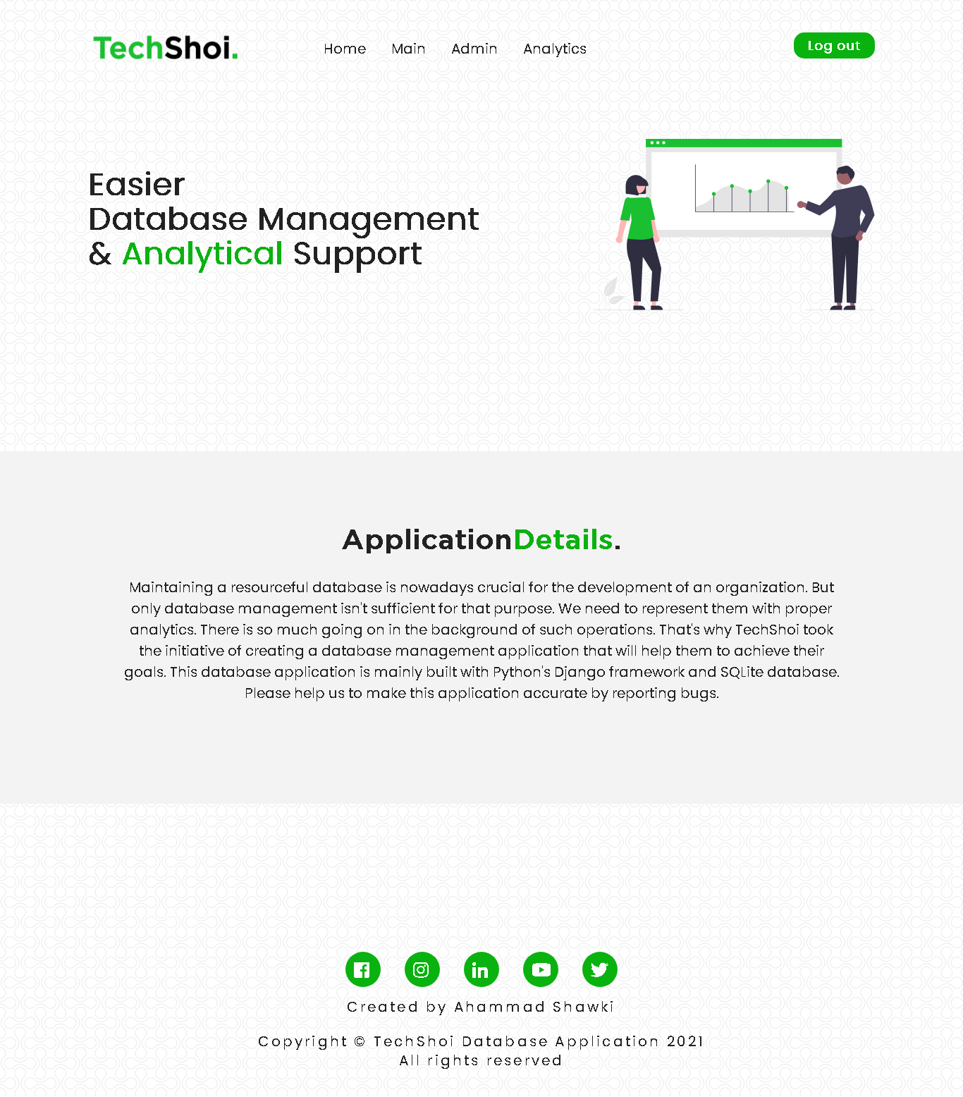
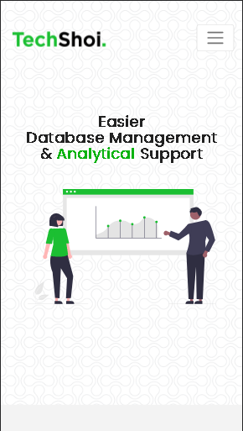
Home Page

Slide 22
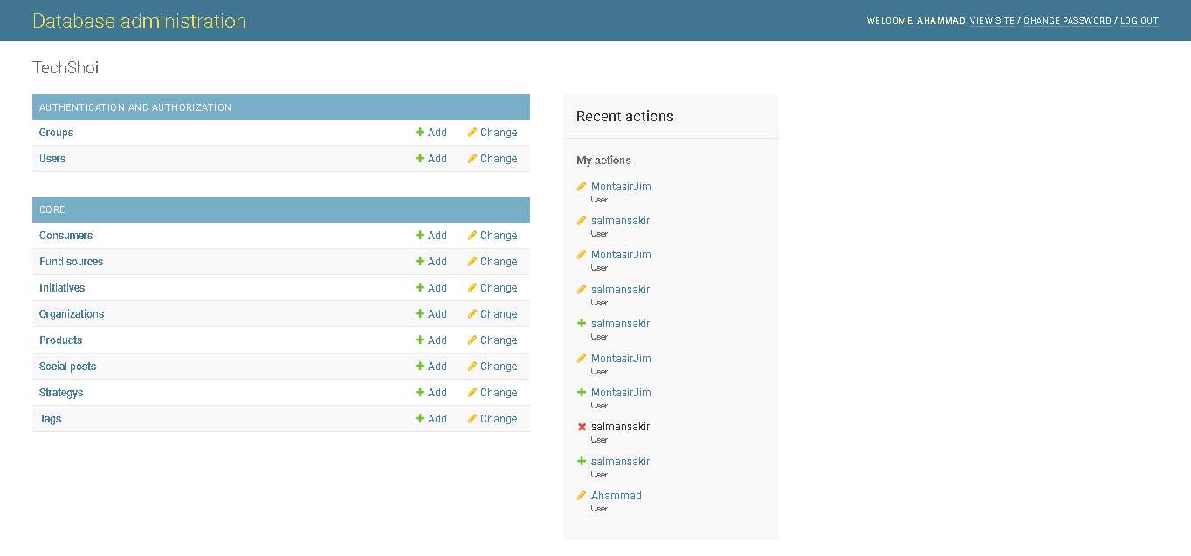
Admin Page

Slide 23
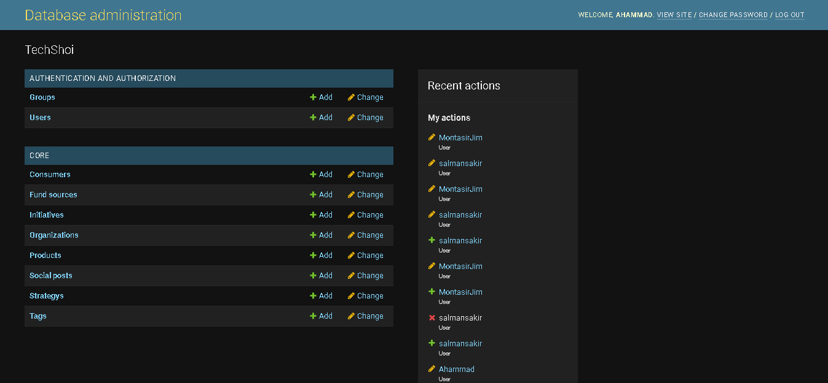
Admin Page

Slide 24
Admin Page

Slide 25
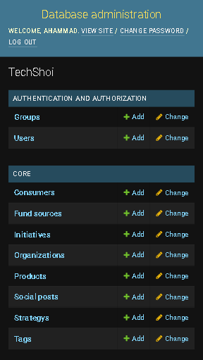
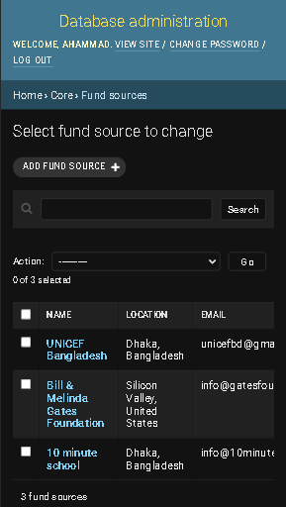
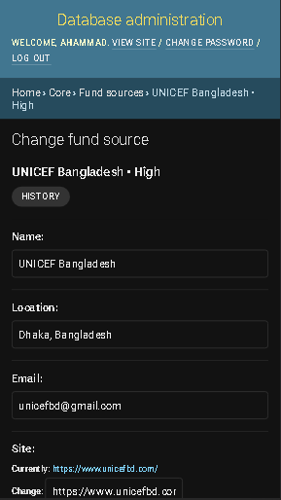
Admin Page

Slide 26
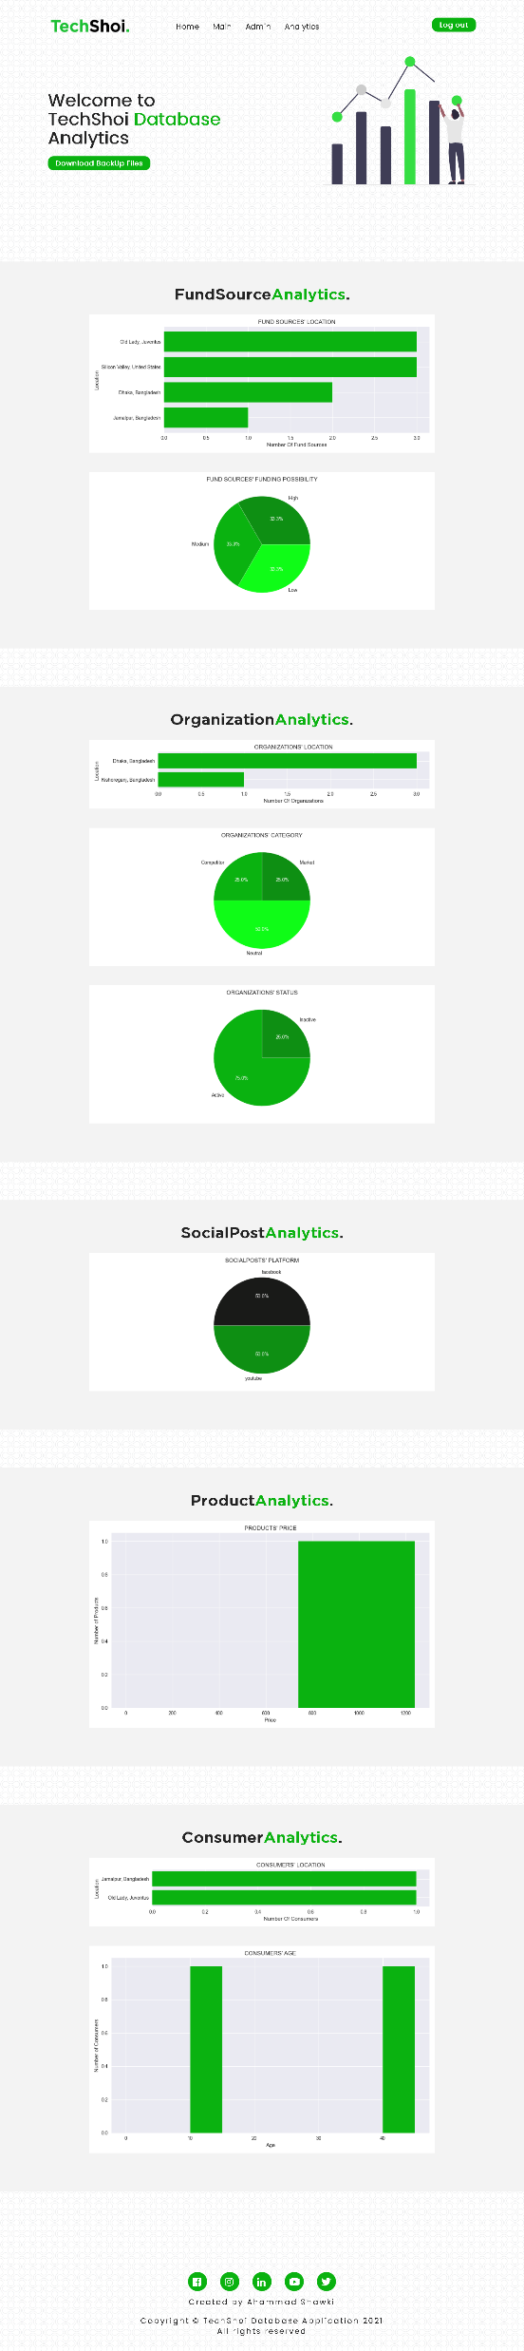

Analytics Page

Slide 27

Analytics Page

Slide 28
Quick Recap
Features
Access data easily ✔
User friendly interface ✔
Customizable with-comment code ✔
Universally unique identifiers ✔
Backup data in excel sheets + Data Recovery Strategy✔
Data analysis support ✔
4 layered Security Measurements ✔
Responsive Web Application ✔
Data Entry Focused Application ✔
Bug Report ✔
Debug is always turned on ✔
Dark Theme Admin Site ✔
Ahammad Shawki

